Slide 1
TBL 2
Answers in the "Notes"

Slide 2
Q.1. A 62-year-old women s undergoing left hemicolectomy for colonic adenocarcinoma. During this procedure her blood pressure dorps resulating in hypotension that persists for more than 20 minutes despite intervention with pressor agents. Which of the following pathologic lesions is most likely to occur in her brain as a consequence of this prolonged hypotensive episode?
A Lacunar infracts of pons
Linear parasagittal infraction
Parietal lobe hemorrhagic infraction
Anterior pituitary necrosis
Hemorrhagic infraction in basal ganglion
Notes:
B
(The most sensitive areas of the brain to ischemia will be the 'watershed' areas between anterior and middle cerebral arterial circulations.)
---
Source
http://www.uaz.edu.mx/histo/webpatutah/EXAM/MULTORG/CNS1FRM.HTM

Slide 3
Q.2. A previously healthy 43-year-old women experiences a sudden sever headache and loses consciousness within an hour. An emergent head CT scan reveals extensive subarachnoid haemorrhage at the base of the brain. She is afebrile. A lumbar puncture yields cerebrospinal fluid with many red blood cells. The CSF protein is slightly increased, but the glucose is normal. Which of the following is the most likely cause of this pathological lesion?
Ruptured berry aneurysm
Ruptured Chorcot Bouchard aneurysm
Amyloid arteriopathy
Fibrinoid necrosis of artrioles
Rupture of AV-malformations
Notes:
A

Slide 4
Q.3. A 48-year-old man presents to the emergency room with sudden onset of sever headache and third nerve palsy. He is afebrile and shows papilledema on funduscopy. A head CT scan shows a 6 cm mass in the right cerebral hemisphere with a midline shift. He dies before further workup can be performed. At autopsy his brain is swollen, gyri are enlarged and flattened along with narrowing of sulci. Pons shows recent a haemorrhage. Which of the following is the most likely cause of his death?
Hydrocephalus ex-vacuo
Cerebral edema with tonsillar herniaction
Cerebral edema with subfalcine herniation
Cerebral edema with uncal herniation
Non-communicating hydrocephalus due to ependymoma
Notes:
C

Slide 5
Q.4. Which one of the following statement regarding CNS vascular disorder is correct?
Red neurons are typically seen with in first 4 hours after acute ischemic injury.
Slit hemorrhages are associated with mycotic aneurysm.
In pseudo laminar necrosis all layers of neocortex are destroyed.
Hemorrhagic infracts are typically associated with thrombosis.
Pyramidal cells of hippocampus & neocortex are most susceptible to ischemic changes.
Notes:
E

Slide 6
Q.5. A known heroin addict was brought to the ER in an unconscious state. In oreder to ascertain the acuse of coma, a thorough physical examination was perforemed. Based on the physical findings, the doctor ruled out heroin as the cause of unconsciousness.
Which one of the following findings would rule out heroin as the cause of coma in this case?
Miosis
Hypotension
Mydriasis
Repiratory depression
Vomiting
Notes:
C

Slide 7
Q.5. A 45-year-old obese lady presented with acute abdominal pain the right hypochondrium. After physical and ultrasonic examination, a diagnosis of acute cholecystitis was made. She was administered morphine whch aggrabated the pain. The reason for aggravated pain is because morphine:
causes constipation thus increasing the intra-abdominal pressure
does not relieve the pain in gall bladder
enhances production of bile in liver
increases intrabiliary pressure
causes spasm of the gall bladder
Notes:
D

Slide 8
Q.7. Khalid is a 60-year-old man with type II diabetes. He presents to the healthy center complaining of numbness in his hands and feet. Sensory testing showed that he could not feel pin pricks in parts of his toes. Loss of which of the following type of sensory endings is likely to account for these findings?
Ruffini corpuscles
Merkel cell recptors
Pacinian corpuscles
Free nerve endings
Meissner's endings
Notes:
D

Slide 9
Q.8. A 72-year-old man was diagnosed with conduction aphasia due to a lesion affecting his left arcuate fasciculus. Which of the following is likely to be observed in this patient?
Very poor comprehension of spoken language
Very poor comprehension of written language
Absecnce of spontaneous speech
Spontaneous but incomprehensible speech
Speech interrupted by long pauses to search for words
Notes:
E

Slide 10
Q.9. Following injury, an athlete may not feel much pain during the excitement of the game because of activation of the body's endogenous analgesia system. In this system, nociceptive (pain) input in the spinal cord is inhibited by descending fibres arising mainly from:
limbic cortex
basal nuclei
deep nuclei of the cerebellum
midbrain periaqueductal gray matter
ventral postero-lateral nuceli of the thalamus
Notes:
D

Slide 11
Q.10. During an fMRI study, a subject was given instructions which led to neuronal activation of only the supplementrary motor area of the LEFT frontal lobe. Which of the following might have been the instruction given?
Take a deep breath
Flex tour left index finger
Make a fist with your right hand
Trace (write) the letter B with your right index finger
Think of tracing (writing) the letter B with your right index finger
Notes:
E

Slide 12
Q.11. A patient has suffered a stroke caused by occlusion of the right anterior cerebral artery. This patient is most likely to present with:
a loss of pain and temperature sensations in the left leg
weakness of the right leg
drooping of the corner of the mouth on the left
a nonfluent aphasia
a loss of discriminative touch from the right side of the face
Notes:
A

Slide 13
Q.12. Your female patient has suffered a stroke. She has difficulty copying simple diagrams, even though she hears and understands your requests to do so. You noticed that she only has make-up on the right side of her face and does not seem to know where her left hand is in space.
Which blood vessel might have been occluded to causes these symptoms?
Left vertebral artery
Right middle cerebral artery
Left anterior cerebral artery
Right posterior cerebral artery
Right anterior cerebral artery
Notes:
B

Slide 14
Q.13. A 70-year-old man was admitted to the hospital with sudden onset of dizziness, hiccups and vomiting. He also complained of painful sensation on the right side of his face and left side of his body. On neurological examination his soft palate was drawn to the left side when he is asked to say "Ah". Indirect laryngeoscope examination showed that he was unable to move his right vocal cord. The patient also showed ptosis in his right eye. Where is the side of the lesions?
Left pons
Right pons
Right medulla
Left medulla
Mid brain
Notes:
A

Slide 15
Q.14. Which of the following structures is responsible for pain and temperature sensation from the right side of the face?
Spinal leminiscus
Medial leminiscus
Lateral leminiscus
Spinal trigeminal leminiscus
Tractus solitarius
Notes:
D

Slide 16
Q.15. A 15-year-old girl was brought to neurological clinic as her mother noticed a weakness on the right side of her face. It was noticed that her mouth was pulled to the left side. On neurological examination there was definite weakness of the facial muscles on the right side. The skin sensation on the face was normal. Her right eye was deviated medially and she was unable to abduct her right eye. She has spastic type of paralysis involving her left arm and leg. Where is the site of lesion in this case?
Left pons
Right pons
Right medulla
Left medulla
Mid brain
Notes:
B

Slide 17
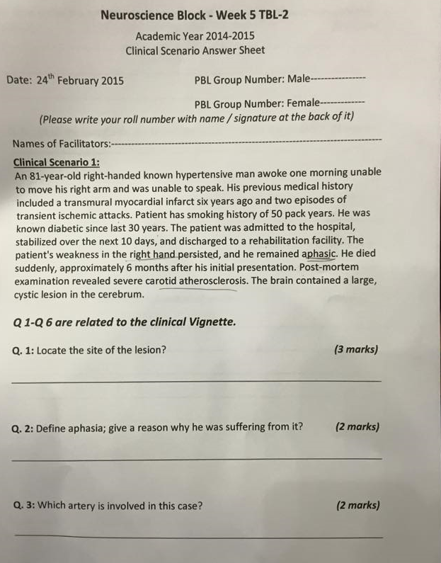
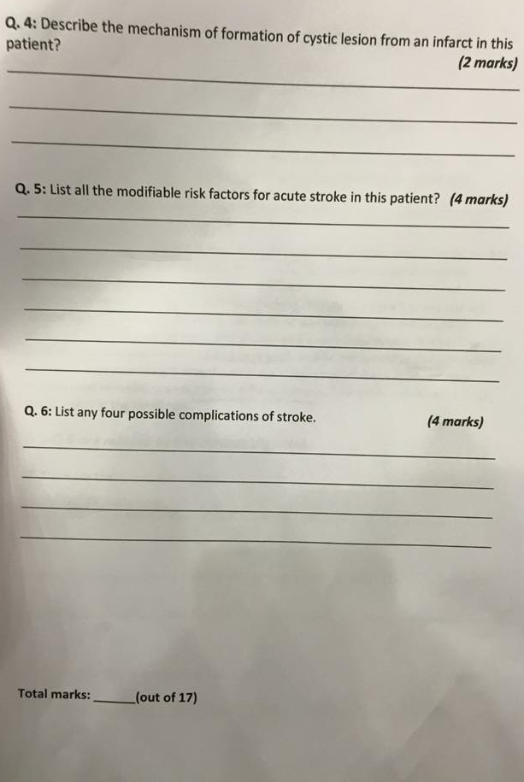
Notes:
.

